Slide 1
Why MadCap Flare Excels Over Microsoft Word for Modern Technical Writing
Tools and Technologies for Technical Writers
Asuman Kazibwe

Slide 2
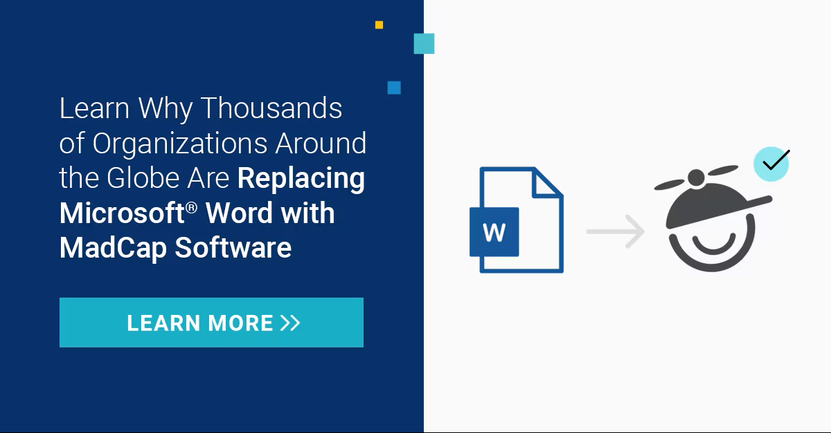
Madcap Vs Word

Slide 3

FAVORITE TOOL: MADCAP FLARE
why
Professional documentation platform
Supports single-source publishing
Creates multiple outputs from one project
Structured and scalable
Strong organization features
Designed for technical documentation

Slide 4
Advantages of MadCap Flare
● Reusable content
● Easy content updates
● Multiple publishing outputs
● Professional appearance
● Better for large projects
● Good for teams and scalability

Slide 5
Drawbacks of MadCap Flare
● Expensive software
● Steep learning curve
● Complex interface for beginners
● Requires planning and organization
● More difficult than Word initially

Slide 6
Why Microsoft Word Is My Least Favorite Tool

Slide 7
Weak structured authoring support
Formatting inconsistencies
Difficult collaboration
Poor scalability
Limited reuse functionality
Not ideal for modern web documentation

Slide 8

Why Microsoft Word Is Still Important
Bullet Points
● Widely recognized
● Easy to learn
● Accessible
● Common in businesses
● Good for quick documents
● Useful for resumes and reports
.
Tip
Use madcap flare..

Slide 9

Better Alternatives for Technical Documentation
● MadCap Flare
● Markdown + GitHub
● DITA systems
● Structured authoring tools
Hint
Life is better with these other tools, at least in technical writing.

Slide 10

Scenario 1
Scenario Requirements
● Sole writer
● Small startup
● Limited funds
● New web app with mobile version
● No translation

Slide 11

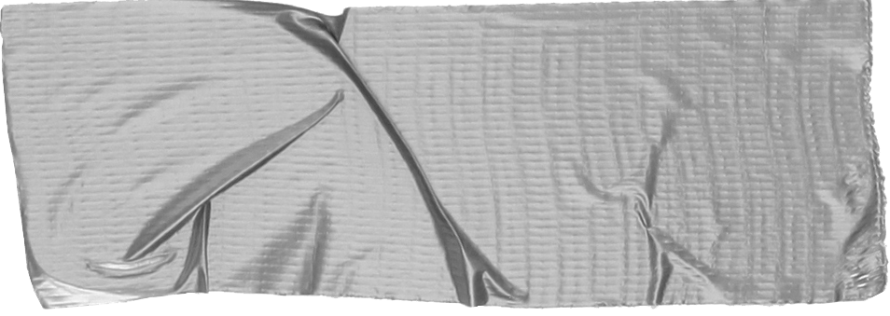
Tools I Would Use for Scenario 1
Bullet Points
● MadCap Flare (if budget allows)
● Markdown
● GitHub Pages
● Read the Docs
answer
Madcap flare

Slide 12
Why These Tools Make Sense
Low cost
Easy maintenance
Web-friendly
Fast updates
Good for agile startups
Better scalability than Word

Slide 13
Final Thoughts
● Different tools solve different problems
● Technical writers must think strategically
● MadCap Flare is powerful for structured documentation
● Microsoft Word still has uses but limitations
● Tool selection depends on project needs

Slide 14
Thank you everyone, and thank you Zoe. I really appreciate everything I’ve learned and the chance to learn alongside all of you. Wishing everyone the best of luck, and thank you again.

